Slide 1
Ateneo de Manila University
Intermediate Macroeconomic Theory
2024.03.07
AGENDA
Macro Modeling
Models for Internal Balance
Aggregate Demand / Aggregate Supply Model
CALLA WIEMER

Slide 2
Macroeconomic Modeling
Purpose: to reason through relationships among
output
price level
policy variables
fiscal: government spending & taxes
monetary: interest rate
for emerging market economies, add
external balance (current account target)
monetary policy variable: exchange rate
Time dimension & equilibrium
comparative static models
dynamic models as comparative statics stepwise
sticky wages and prices
⎫
⎬ internal balance
⎭

Slide 3
Keynesian* model elements
“In the long run, we’re all dead.”
Output can get stuck below potential.
Product prices are sticky due to market power.
Nominal wages are sticky due to contracts and incentive constraints.
Investment demand for loanable funds depends on business expectations (animal spirits), not interest rates.
Saving supply to loanable funds depends on income, not interest rates.
Money demand, which must align with money supply (exogenous), depends on expectations of future interest rates. When interest rates rise, bond prices fall. Hence if interest rates on bonds are low and expected to rise, economic agents prefer the liquidity of money.
*Keynes did not formalize any “Keynesian” model. Others have done so, invoking his name.

Slide 4
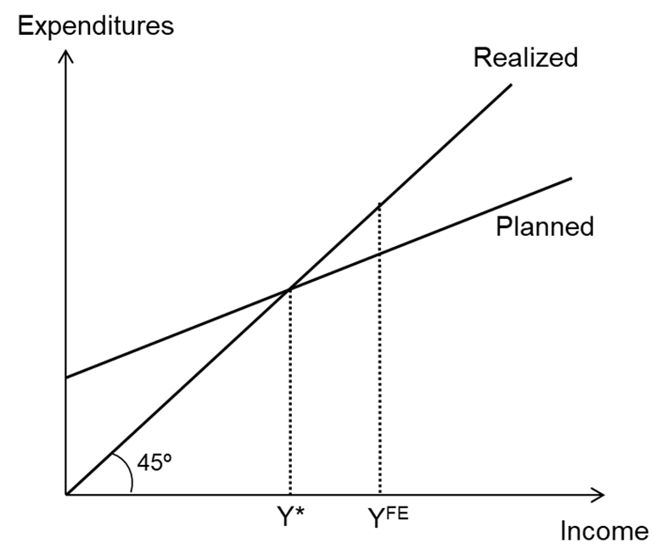
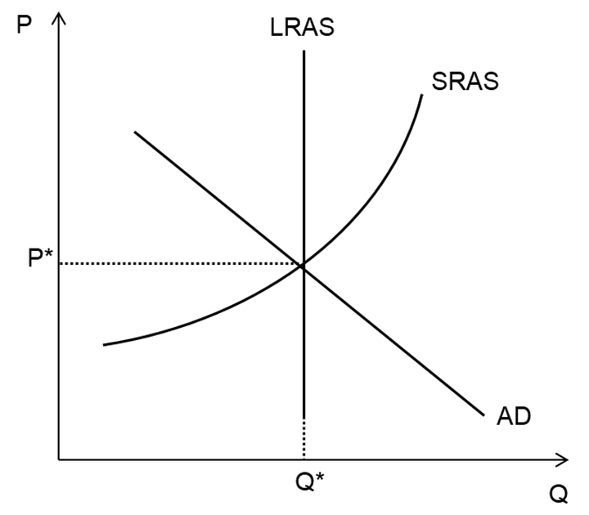
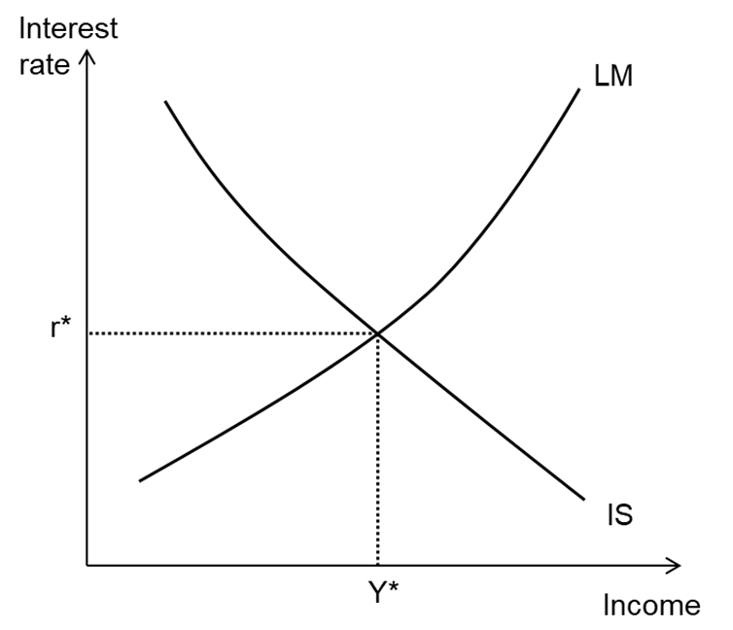
Macro Models for Internal Balance
Fig 9.1
Income-Expenditure Model
Fig 9.3
Aggregate Demand & Supply Model
Fig 9.6
IS-LM Model
Output ≠ potential.
endogenous: income (output)
no prices; no money
policy: fiscal
Long run: output = potential.
Short run: output ≠ potential.
endogenous:
short-run output (income)
prices (wages implicit)
exogenous: long-run output
policy: monetary & fiscal
Output ≠ potential.
endogenous:
income (output)
interest rate
saving=investment
Ms=Md
policy: monetary & fiscal

Slide 5
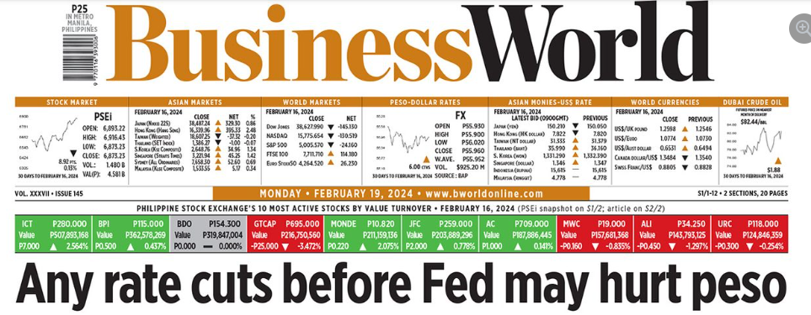
IS-LM: Interest Rate As the Key Monetary Policy Instrument
Small countries with open capital markets have little space for interest rate targeting.
As global financial hubs, Singapore and Hong Kong have NO space.
Rather, per Samuelson & Nordhaus, Macroeconomic Principles* (2010):
“In small open economies, managing the exchange rate is the single most important macroeconomic policy.” (p. 74)
Hence we will not spend time on the IS-LM model but will instead develop a framework that focuses on the exchange rate as a policy instrument oriented toward maintaining balance both internally and externally – the Swan Diagram (Chapter 13).
*The leading textbook before the Mankiw era.

Slide 6
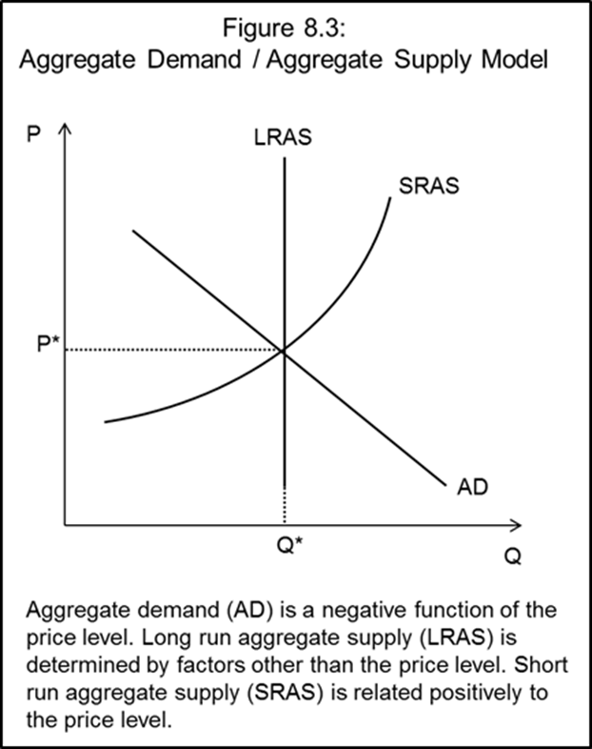
Aggregate Demand / Aggregate Supply Model
Features
incorporates the price level
long run equilibrium determined by real factors
short run wage stickiness causes output fluctuations
AD is related inversely to the price level.
real balance effect
interest rate effect
exchange rate effect
Long run AS is vertical.
Short run AS increases with the price level.
wages adjust to price changes with a lag
P ↑ ⇒ profits ↑ ⇒ employment ↑ ⇒ Q ↑
LR: wages adjust to higher prices to return the economy to Q *.

Slide 7
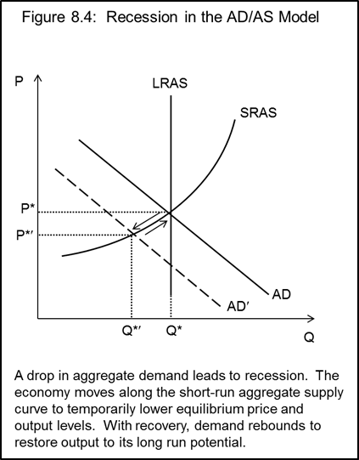
Negative AD Shock
Consider a negative shock to confidence.
investment demand ↓
⇒ AD shifts left
SR: movement along SRAS
weak demand ⇒ P ↓
sticky nominal wages (even as real wages ↑ )
⇒ employment ↓
⇒ Q ↓
LR: AD recovers
durable goods wear out and need replacing
new technologies emerge
hope sprouts
Government can expedite

Slide 8
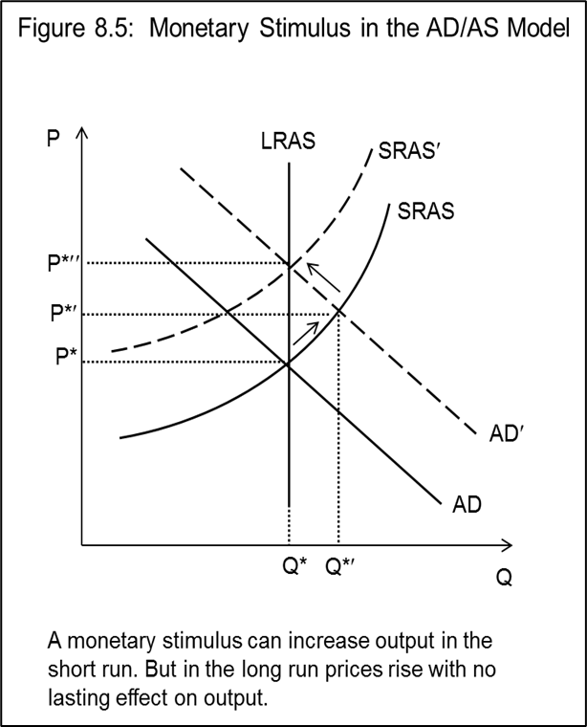
Demand Stimulus Policies
Consider an economy at full capacity
Monetary stimulus ⇒ AD shifts right
SR: P ↑ vs sticky wages ⇒ employment and Q ↑
LR: wages catch up ⇒ SRAS shifts left
⇒ employment and Q ↓
lasting effect: higher P
Fiscal stimulus ⇒ AD shifts right
SR: same as above
LR: given MV, end to stimulus ⇒ P ↓ ⇒ Q ↓
back to starting point
In sum
effect on output is temporary with either policy
effect on prices is lasting with monetary policy
effect on prices is temporary with fiscal policy

