Slide 1
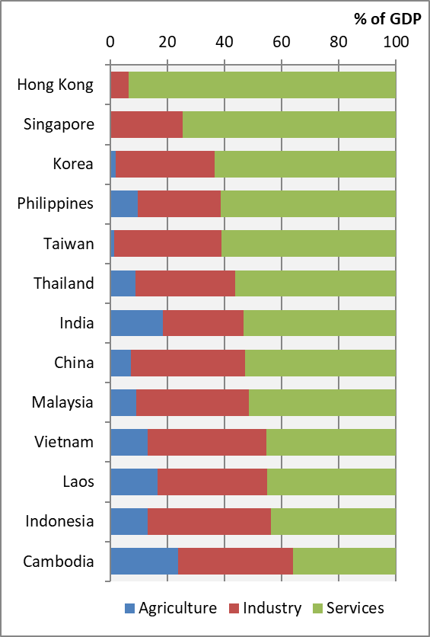
Chart 4.2 GDP by Sector, 2022

