Slide 1
Ateneo de Manila University
Intermediate Macroeconomic Theory
2024.02.19
AGENDA
Homework #3
Forex Market Mechanics
Forex Market Size
Effective Exchange Rates
Exchange Rate Determination
CALLA WIEMER

Slide 2
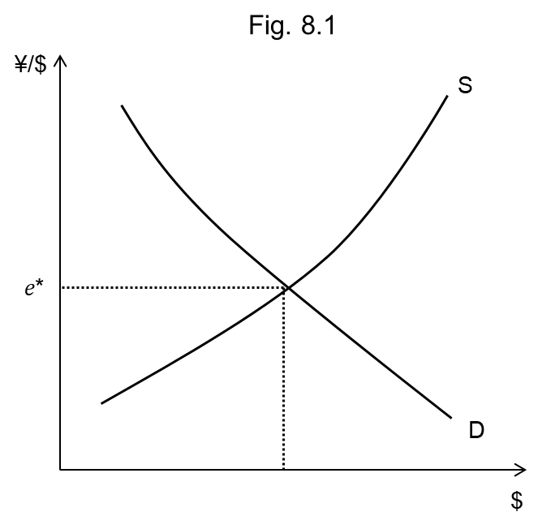
Market for Dollars Priced in Yen
Supply of Dollars
comes from:
Japanese exports to US
purchase of Japanese assets by Americans
sale of assets held in US by Japanese
CREDITS ON JAPAN’s BoP
Demand for Dollars
comes from:
Japanese imports from US
purchase of US assets by Japanese
sale of assets held in Japan by Americans
DEBITS ON JAPAN’s BoP

Slide 3
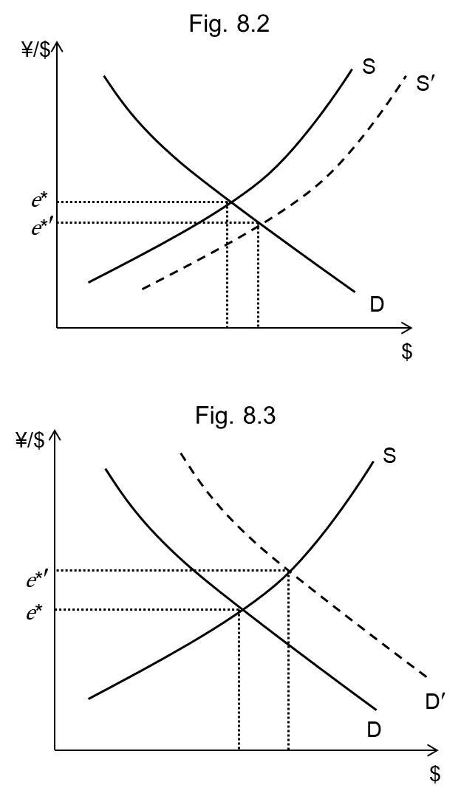
Demand & Supply Shifts in the ¥/$ Market
Factors that increase the supply of dollars
Americans show greater preference for Japanese goods
U.S. real GDP growth rises
the real rate of return on Japanese assets increases
the real rate of return on US assets falls
expectations arise that the $ will depreciate vs the ¥
the rate of US inflation increases
Result: yen appreciates vs the dollar
Factors that increase the demand for dollars
Japanese show greater preference for American goods
Japanese real GDP growth rises
the real rate of return on US assets increases
the real rate of return on Japanese assets falls
expectations arise that the $ will appreciate vs the ¥
the rate of Japanese inflation increases
Result: yen depreciates vs the dollar

Slide 4
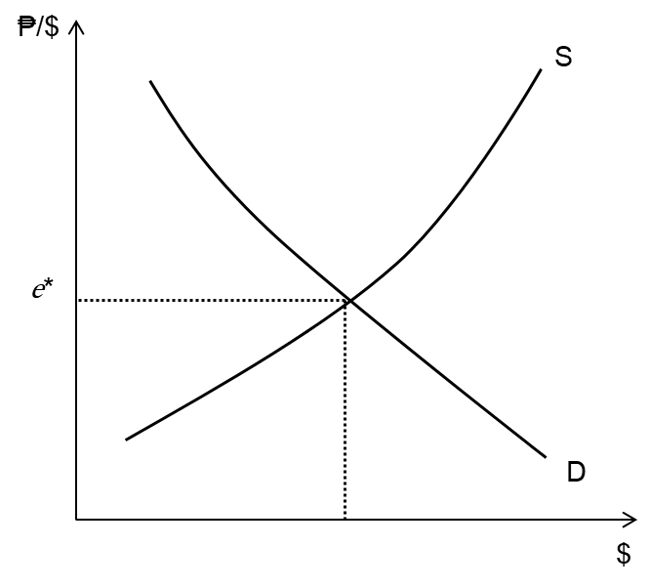
Dutch Disease, Philippine Style
Suppose the graph represents the market for USD priced in PHP under the counterfactual of no remittances.
Q: How do we represent the impact of remittances?
Q: How does this affect the value of the peso?
Q: What are the implications for exports? … for imports?

Slide 5
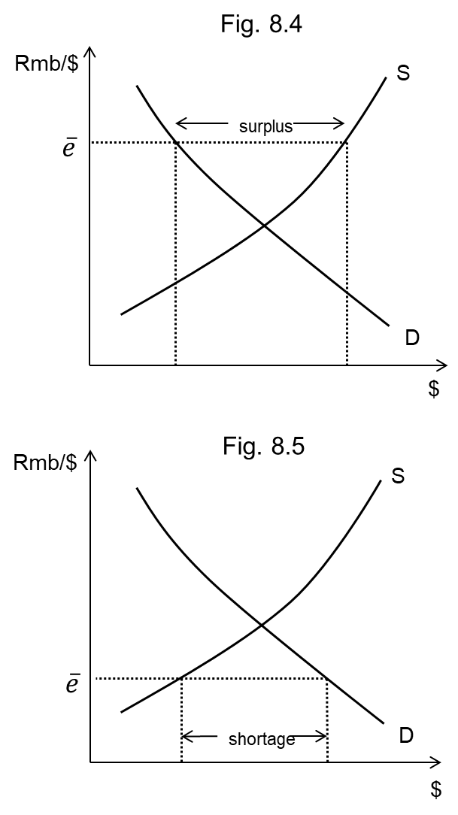
Fixed Exchange Rates: Chinese Rmb to USD
Central bank intervenes to fix exchange rate
Figure 8.4
at $\overline{e}$:
$ is overvalued ($1 buys more Rmb)
Rmb is undervalued (takes more Rmb to buy $1)
surplus of $ results
What must central bank do to maintain $\overline{e}$?
Figure 8.5
at $\overline{e}$:
$ is undervalued ($1 buys fewer Rmb)
Rmb is overvalued (takes fewer Rmb to buy $1)
shortage of $ results
What must central bank do to maintain $\overline{e}$?
Which of these situations is more sustainable?

Slide 6
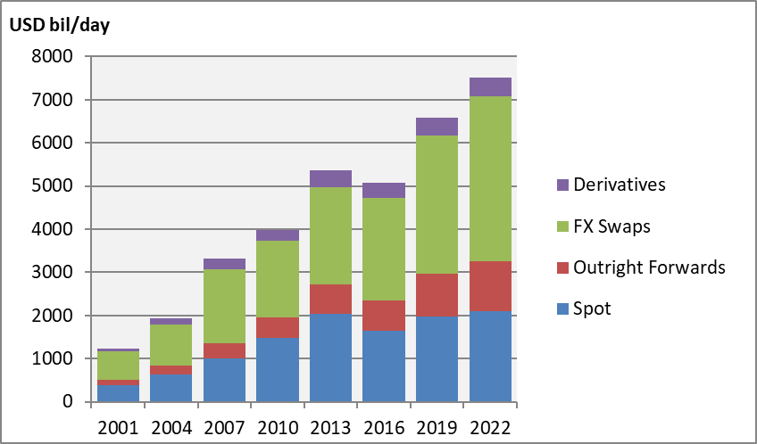
Chart 8.1 Forex Turnover by Instrument
Turnover in 2022 = $7.5 trn/day
(wholesale dealers)
Compare:
world stock market trade
$161trn/yr (2021)
world merchandise trade
$25trn/yr (2022)

Slide 7
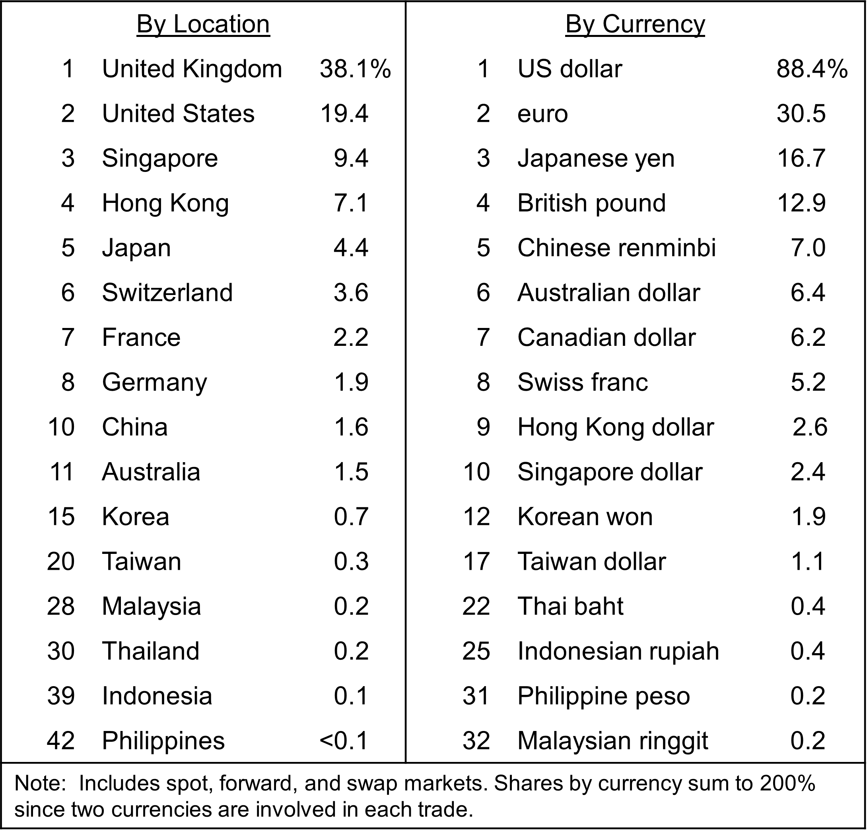
Table 8.1 Forex Market Ranking & Shares, 2022

Slide 8
Effective Exchange Rates
Bilateral exchange rate is between two currencies, say USD/IDR
EERs measure movement over time of one currency relative to a basket of currencies
(expressed as indexes relative to a base year value of 100)
Nominal vs real
nominal effective exchange rate (NEER) is in current year prices
real effective exchange (REER) rate is in prices of a base year
Consider a peg to the US dollar of the rupiah
dollar nominal appreciation relative to other currencies ⇒ rupiah NEER appreciation
inflation in Indonesia > elsewhere ⇒ rupiah REER appreciation

Slide 9
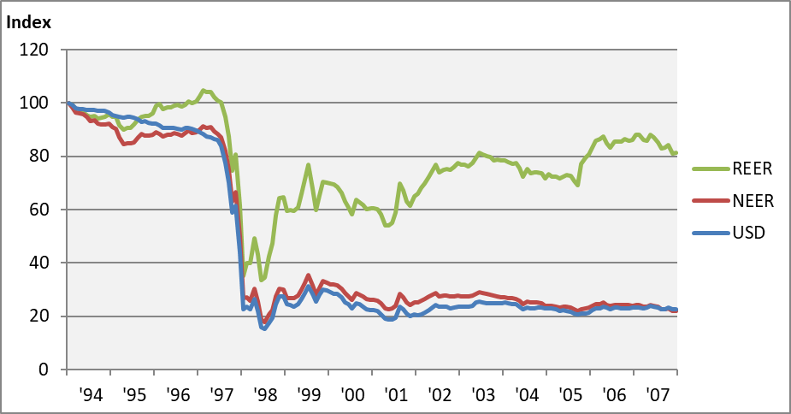
Indonesia’s Exchange Rate, 1997-2007

Slide 10
Exchange Rate Determination
Market forces
Purchasing power parity
trade account in the balance of payments
arbitrage ⇒ “Law of One Price”
$e_{IDR/USD}=\frac{P_{IDR}}{P_{USD}}$ where P_{x} is the price of a basket of traded goods in currency x
Interest parity
financial account in the BoP
interest arbitrage ⇒ expected real rates of return equalize
where equilibration is a process
Central bank intervention
according to exchange rate regime (arrangement)
floating rate
fixed rate
in between … circumstance / judgment

