Slide 1
Ateneo de Manila University
Intermediate Macroeconomic Theory
2024.02.22
AGENDA
Effective Exchange Rates
Exchange Rate Regimes
Balance of Payments Adjustment
Lean against the Wind
CALLA WIEMER

Slide 2
Effective Exchange Rates
Bilateral exchange rate is between two currencies, say USD/IDR
EERs measure movement over time of one currency relative to a basket of currencies
(expressed as indexes relative to a base year value of 100)
Nominal vs real
nominal effective exchange rate (NEER) is in current year prices
real effective exchange (REER) rate is in prices of a base year
Consider a peg to the US dollar of the rupiah
dollar nominal appreciation relative to other currencies ⇒ rupiah NEER appreciation
inflation in Indonesia > elsewhere ⇒ rupiah REER appreciation

Slide 3
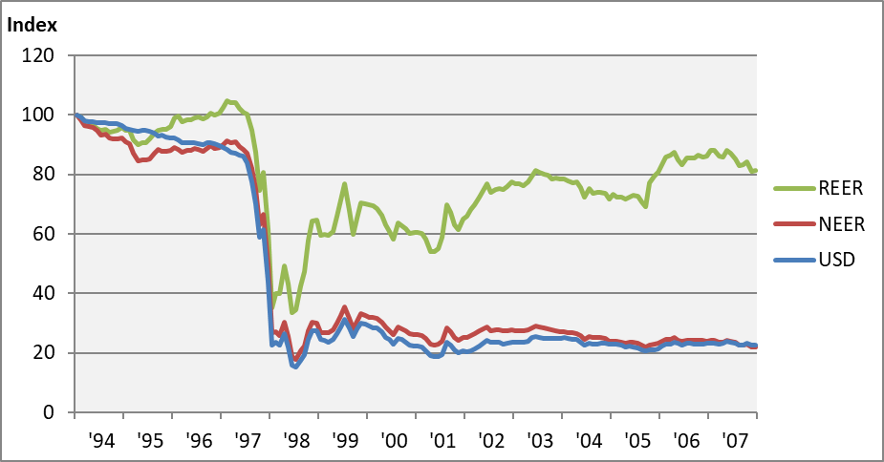
Indonesia’s Exchange Rate, 1997-2007

Slide 4
Exchange Rate Determination
Market forces
Purchasing power parity
trade account in the balance of payments
arbitrage ⇒ “Law of One Price”
$e_{IDR/USD}=\frac{P_{IDR}}{P_{USD}}$ where P_{x} is the price of a basket of traded goods in currency x
Interest parity
financial account in the BoP
interest arbitrage ⇒ expected real rates of return equalize
where equilibration is an ongoing process
Central bank intervention
according to exchange rate regime (arrangement)
floating rate
fixed rate
in between … circumstance / judgment

Slide 5
Exchange Rate Regimes
Fixed
advantages
stable business climate; minimizes exchange rate risk
anchors monetary policy; imposes macroeconomic discipline
can be used to stockpile official reserves
disadvantages
misalignment leads to payments imbalances and speculative attacks
must subordinate monetary policy and/or control capital flows
provokes ire of the US
Floating
advantages
quick response to shocks (terms of trade; $/yen/euro rates)
monetary policy independence
disadvantage
prone to excessive volatility
Intermediate
stabilize against transitory shocks
but track toward long-run equilibrium

Slide 6
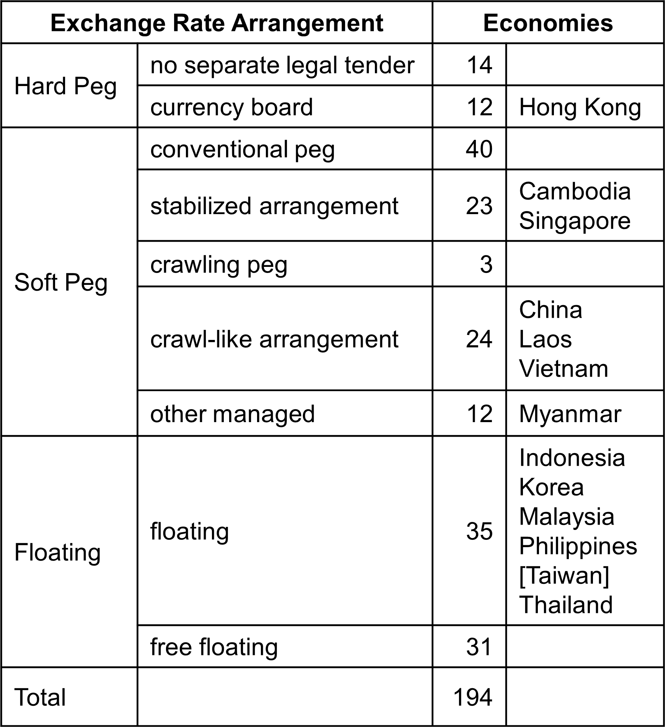
Table 8.2 Exchange Rate Arrangement, 2022
Notes:
IMF Annual Report on Exchange Arrangements and Exchange Restrictions 2022
https://www.imf.org/en/Publications/Search?#sort=relevancy&f:series=[ANNREPEAER]&DateTo=12%2F31%2F2023&DateFrom=1%2F1%2F2023

Slide 7
Balance of Payments Adjustment
The balance of payments must balance.
The impact of a shock to one element of the BoP must be aborbed by other elements.
floating exchange rate: market equilibration ensures
demand for forex = supply of forex
debits on the BoP = credits on the BoP
fixed exchange rate: central bank intervenes to ensure overall balance
Can the central bank do this indefinitely?

Slide 8
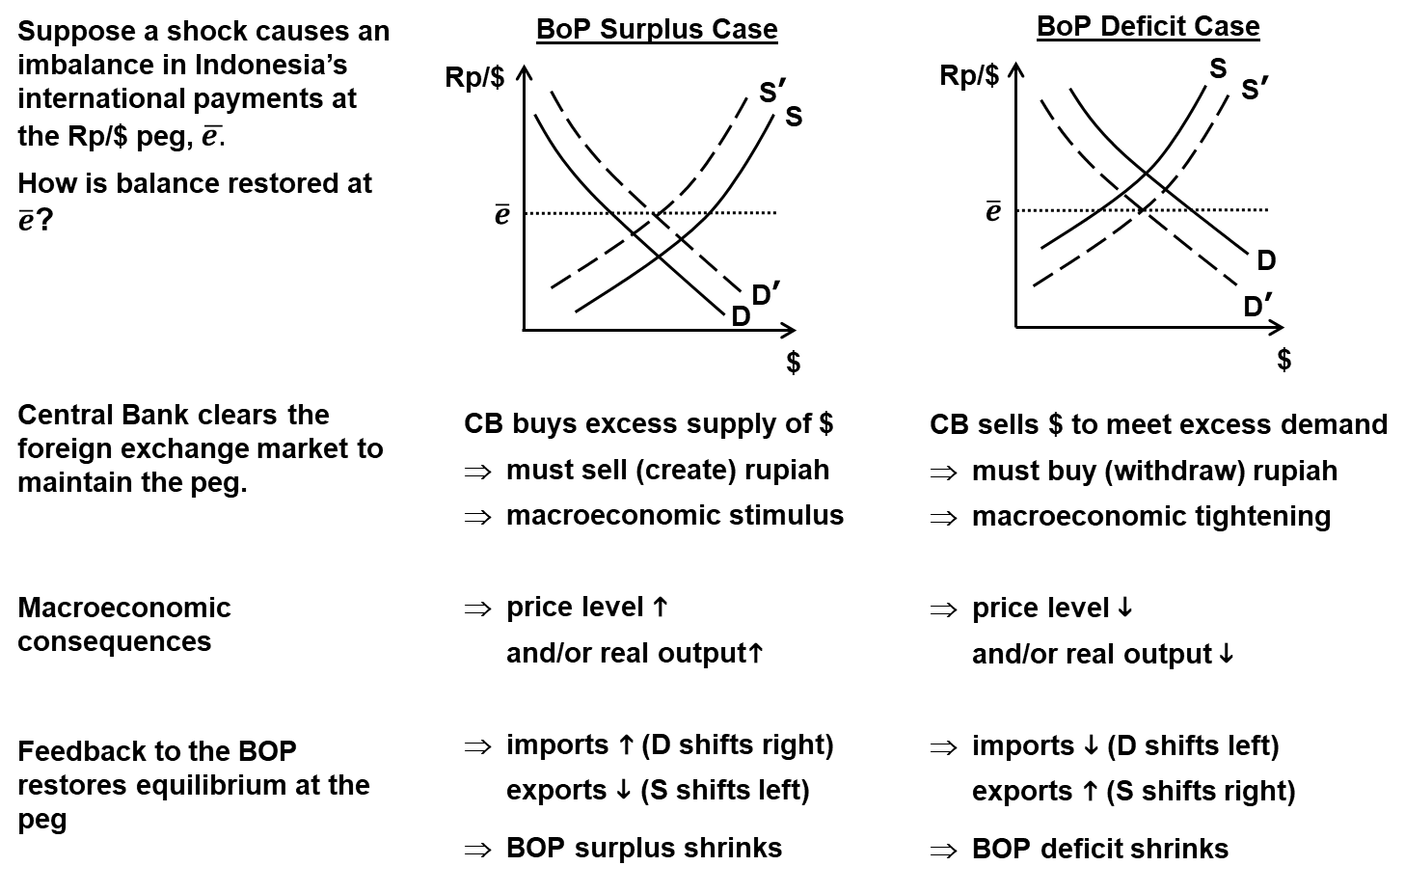
Box 8.3 Balance of Payments Adjustment, Fixed Exchange Rate

Slide 9
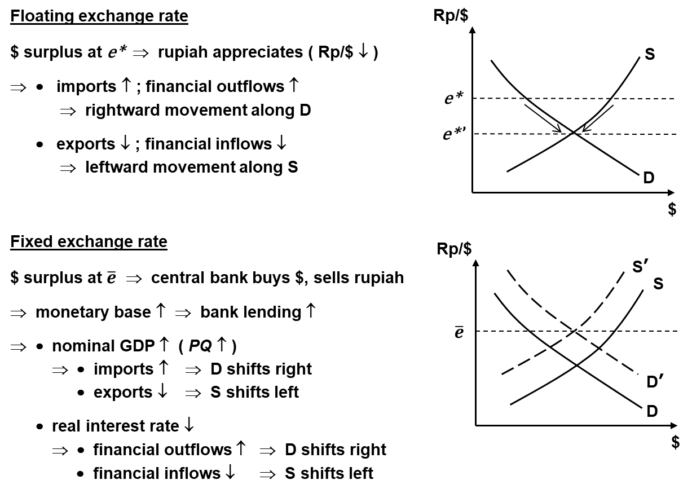
Box 8.4 Balance of Payments Adjustment, Floating vs Fixed Rates
Suppose a shock causes an imbalance in Indonesia’s international payments at the prevailing exchange rate such that a surplus (or incipient surplus for a floating rate) emerges.
How is balance restored under floating vs fixed exchange rates?

Slide 10
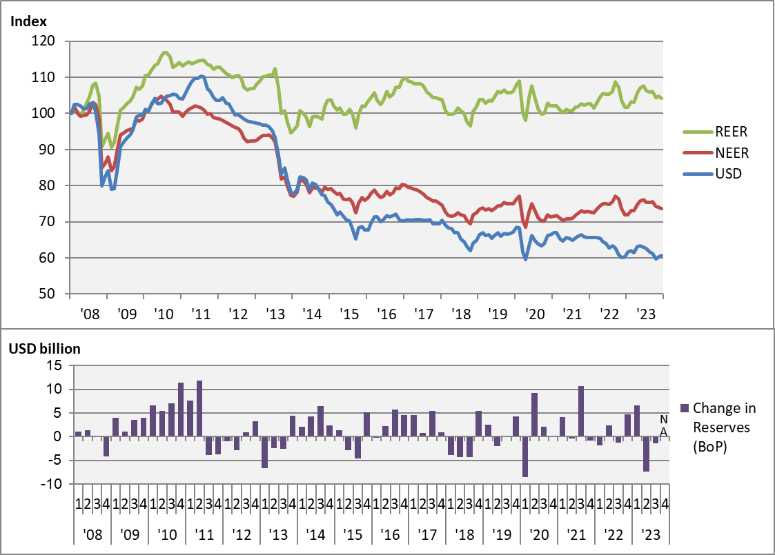
Chart 8.3 Exchange Rate Indexes & Reserves, Indonesia, 2008-2023

Slide 11
Managing External Shocks: A Middle Course
For a small open economy with modest financial markets …
Polar exchange rate regimes have disadvantages.
free floating: exchange rate volatility disrupts planning/commitment
hard peg: central bank intervention disrupts domestic money and credit
Take a middle course: buffer external shocks w/ judicious forex market intervention
conditional on maintaining adequate forex reserves
currency appreciation (BoP credit) shock: central bank buys forex
foreign capital inflows
price increases for exports / decreases for imports
currency depreciation (BoP debit) shock: central bank sells forex
foreign capital outflows
price increases for imports / decreases for exports
Lean against the wind.
source

