Slide 1
Ateneo de Manila University
Intermediate Macroeconomic Theory
2024.02.08
AGENDA
Homework #2
Money Creation
Money & the Economy
CALLA WIEMER

Slide 2
What Is Money?
Form
specie (metal) or other material of value
paper
representative or fiduciary
fiat
deposit money
Function
medium of exchange
unit of account
store of value
Concept: Effectively, money represents claims on a society.

Slide 3
Money Creation
Old days
gold deposited at a commercial banks
against which banks issues notes
… in multiples
US 1860s
1600 note issuing banks, many defunct
7000 different notes
periodicals reporting status
Modern times
claims against the central bank take the place of gold
against which commercial banks issue deposit money
… in multiples

Slide 4
Table 6.1 Balance Sheet of the Central Bank of Myanmar, 2017
in kyats billion
Assets |  | Liabilities
Net Foreign Assets | 6,616 | Currency In Circulation | 12,669
Claims on Commercial Banks | 777 | Deposits of Commercial Banks | 4,213
Net Claims on Central Government | 13,674 | Other (Net) | 4,185
TOTAL | 21,067 | TOTAL | 21,067
The central bank:
creates money by creating liabilities on its balance sheet;
and also “makes money” by receiving interest on its assets but paying little or no interest on its liabilities
Money created by the central bank called:
base money
reserve money
high-powered money
outside money
central bank money
M0

Slide 5
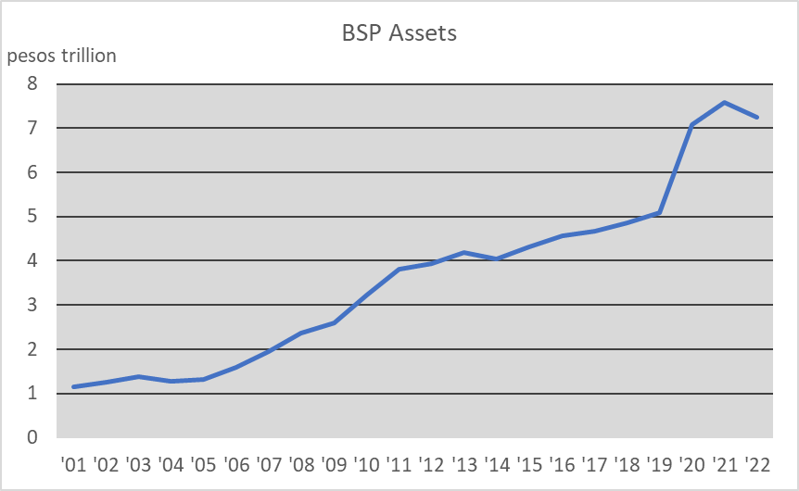
Assests of the Bangko Sentral ng Pilipinas, 2001-2022

Slide 6
Money Creation & Sterilization
By issuing liabilities against itself, the central bank creates base money = M0
… and uses this base money to purchase assets.
foreign assets = FA
loans to commercial banks = LB
loans to government = LG
Let Δ represent change in a variable.
Change in assets = change in liabilities:
ΔM0 = ΔFA + ΔLB + ΔLG.
Central bank purchase of foreign exchange ⇒ ΔFA > 0.
But suppose the central bank reduces loans to commercial banks by the same amount:
ΔFA—ΔLB = 0
This is sterilization of the foreign exchange market intervention.
Q: Why would the central bank do this?

Slide 7
Money Multiplier
The commercial banking system creates deposit money in a multiple of base money.
M1 = currency in circulation + demand deposits
M2 = M1 + time deposits
Let us figure out the multiplier represented by ΔM2/ΔM0 = m.
The multiplier depends on:
share of M0 the public holds as currency: c = ΔC/ΔM0;
share of deposits commercial banks hold as reserves (vs making loans): r = ΔR/ΔD.
By definition: ΔM2 = ΔC + ΔD;
ΔM0 = ΔC + ΔR.
Substituting: ΔM2 = c ΔM0 + (1/r )ΔR
= c ΔM0 + (1/r )(ΔM0 – cΔM0)
= [c +(1/r )(1-c )]ΔM0
= m ΔM0.
c = 1 ⇒ m =1
c = 0 ⇒ m = 1/r > 1
r → 0 ⇒ m → ∞

