Slide 1
Ateneo de Manila University
Intermediate Macroeconomic Theory
2024.03.11
AGENDA
Presentations: Saving & Investment
Booboo Parida
Ryan Pagcatipunan & Chadd Naval
Homework #5
Business Cycles History of Thought
Exam return
CALLA WIEMER

Slide 2
Business Cycles: Two Schools of Thought
Exogenous shocks – the dominant paradigm
deviations from potential growth as aberrations
follows the Classical orthodoxy
mathematically tractable
but the unexplained is at only one remove: Where do the shocks come from?
Endogenous cycles – insight from the fringes
internal process drives expansion and contraction
dynamic – vs comparative statics of both Classical & Keynesian economics
not mathematically tractable
exogenous shocks are still part of the story but endogenous cyclical processes influence vulnerability

Slide 3
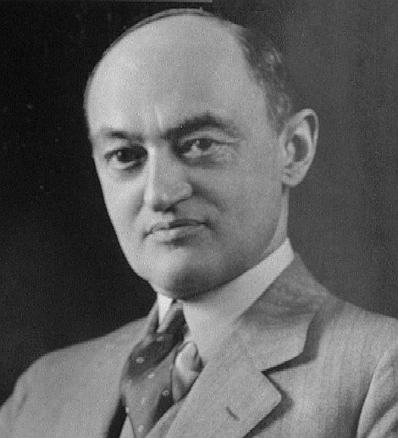
Schumpeter’s Indictment
Schumpeter, Joseph A. (1954), History of Economic Analysis
An “indictment stands against the vast majority of the economists … : with few exceptions, of which Marx was the most influential one, they treated cycles as a phenomenon that is super-imposed upon the normal course of capitalist life and mostly as a pathological one; it never occurred to the majority to look to business cycles for material with which to build the fundamental theory of capitalist reality.” p. 1135
Joseph Schumpeter
1883-1950
Why: “Most [theories of the business cycle] were bound to appeal to economists who had developed economic statics as the centerpiece of their science. As we have seen above, they naturally exaggerated the importance of their central achievement. They saw more in it than … a logical schema that is useful for clearing up certain equilibrium relations but is not in itself directly applicable to the given processes of real life. They did not realize how many and how important the phenomena are that escape this logical schema and loved to believe that they had got hold of all that was essential and ‘normal.’ Now, from the standpoint of this type of analysis, it is natural to locate the ‘causes’ of observed disturbances either outside of the economic system or in the fact that the economic engine, like any engine, never works with precision.” p. 1132

Slide 4
How to Understand the Great Financial Crisis of 2008-9?
Larry Summers, interviewed by Martin Wolf about the Great Financial Crisis, 2011
https://www.youtube.com/watch?v=Vgg5DoPkgYc , 6:05-18:35
Wolf: “a profound failure in modern economics”
Summers:
“Economics knows a fair amount, and economics has forgotten a fair amount.”
There is a lot about the crisis in Bagehot (1873), Minsky (1986), Kindleberger (1978).
Why we forgot
30 years of financial stability led to models based on financial stability
stability followed on an inflationary period instigated by Keynesian policies
scientific models adopted to study problems that were more tractable
(less tractable being asset volatility, bank runs, multiple equilibria)

Slide 5
Mills vs Pigou
Endogeneity of Mills (1867)
cycles are due to interplay of credit and “mental mood” – swinging from excitement to panic
“As credit is a thing of moral essence, the external character of each stage of its devolopement is traced to a parallel change of mental mood.”
credit feeds the boom and starves the bust
the remedy?
not to avert panic: “Panics do not destroy capital; they merely reveal the extent to which it has been previously destroyed by its betrayal into hopelessly unproductive works.”
rather, aiming at the boom, education could forestall the “liability to an ignorant speculative excitement, and a willingness to take immoral risks.”
Exogeneity of Pigou (1927)
types of shock
real: harvests; technology; natural resource discoveries; labor disputes; tastes; foreign demand
monetary: government instigated, working through interest rate and bank lending
psychological: errors ofoptimism/pessimism
mass effect through “a quasi-hypnotic system of mutual suggestion”
boom can lead to bust with the error of pessimism “born, not an infant, but a giant. … an excited man passes from one form of excitement to another more readily than he passes to quiescence.”
but friction brings gyrations to rest

Slide 6
Austrians vs Keynesians
Cycle Theory of the Austrian School
(out of WWI & Russian Revolution)
Ludwig von Mises, Freidrich Hayek
free marketeers, countering socialism
cycles due to a single form of shock:
government mismanagement of the money supply
Mises: a “boom is built on the sands of banknotes and deposits. It must collapse.”
monetary stimulus (politcally motivated)
⇒ interest rate ↓
⇒ investment misallocated to projects of too long gestation
temptation to avoid bust with more credit
this “would at best only interrupt, disturb, and prolong the curative process of the depression, if not bring about a new boom with all its inevitable consequences.”
Static Demand Shortfall of Keynesians
(out of the Great Depression)
malaise due to insufficient aggregate demand
problem: animal spirits
solution: government spending
validated by WWII spending bringing recovery

Slide 7
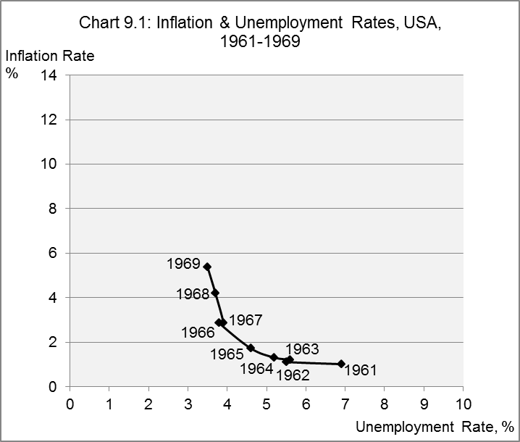
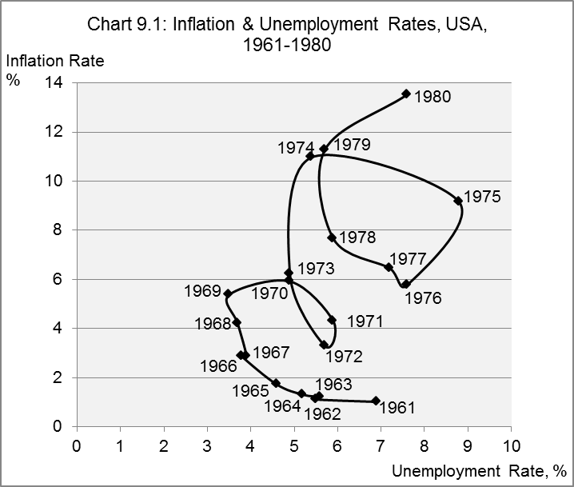
Neoclassical Synthesis between Classical & Keynesian models
Synthesis
LR classical equilibrium theory
SR Keynesian wage/price stickiness
⇒ government stimulus to expedite adjustment
Phillips Curve interpretation
can stimulate demand for recovery
but will push up inflation
US 1961-69 validation
… 1970s upheaval
Stagflation controverted Neoclassical Synthesis

Slide 8
Natural Rate Theory
Friedman (1968) & Phelps (1967)
Natural rate of unemployment
unemployment rate in equilibrium determined by frictions matching workers & jobs
government stimulus can push unemployment below this natural equilibrium
but only with rising inflation
Expectations of inflation matter
adaptive expectations are based on past experience
nominal wages are set to achieve an expected real outcome
Monetary policy implications
stable inflation ⇒ unemployment stabilizes at the natural rate
reducing unemployment below the natural rate ⇒ inflation must accelerate (surprise!)
reducing inflation ⇒ unemployment rate will rise
NAIRU
natural rate of unemployment = the non-accelerating-inflation rate of unemployment
Conclusion: 1960s Keynesian policies unleashed a world of trouble

Slide 9
Rational Expectations Theory
Lucas (1972)
Adaptive expectations
based on past experience
accelerating inflation will leave workers accepting lower real wages
⇒ systematic monetary policy can have an impact on output
Rational expectations
based on full information about economic conditions
expectations incorporate likely range of actions by the monetary authority
not perfect foresight
people can be fooled, just not systematically fooled
⇒ systematic monetary policy has no impact on output
an anticipated monetary stimulus will be met with an immediate nominal wage increase
New Classical Economics
originally, models in which unforeseen monetary shocks have an impact on output
more broadly, models in which there is no money – real business cycle theory

Slide 10
State of the Art: Dynamic Stochastic General Equilibrium Models
Growth at potential subject to exogenous productivity shocks
Solow growth model: $Y\left(t\right)= A\left(t\right)L{(t)}^{∝}K{(t)}^{1−∝}$
constant productivity growth rate, r : $A\left(t\right)= A\left(0\right)e^{rt}$
stochastic disturbance to productivity, $u(t)$: $A\left(t\right)= A(0)e^{rt}u(t)$
Household utility
labor supply, depends on productivity
consumption and saving decisions
Investment & inventory
drives economy from period to period
Markets clear
Breakdowns (sector, labor types, …) ⇒ thousands of equations
Endogenous cycle theory long lost.
Summers:
“Economics knows a fair amount, and economics has forgotten a fair amount.”

