Slide 1
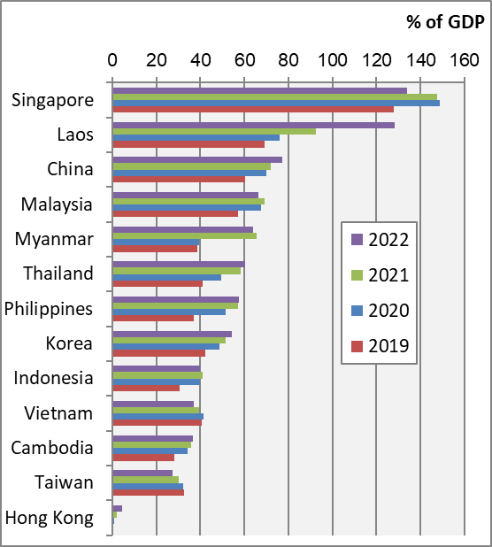
Chart 12.1 Government Debt, 2019-2022
Notes:
Data source: IMF World Economic Outlook Database, April 2023
https://www.imf.org/en/Publications/WEO/weo-database/2023/April
2022 values are estimates for Cambodia, Hong Kong, Korea, Laos, Malaysia, Taiwan, Thailand, and Vietnam.
2021 and 2022 values are estimates for Myanmar.

