Slide 1
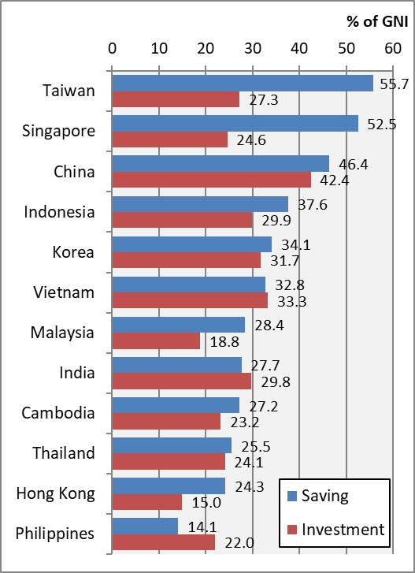
Chart 4.5 Saving & Investment, 2022
Notes:
Note: Chart 4.5 in the text takes GDP as the denominator.
Data sources
World Bank World Development Indicators
China National Bureau of Statistics
National Statistics, Republic of China (Taiwan)

