Slide 1
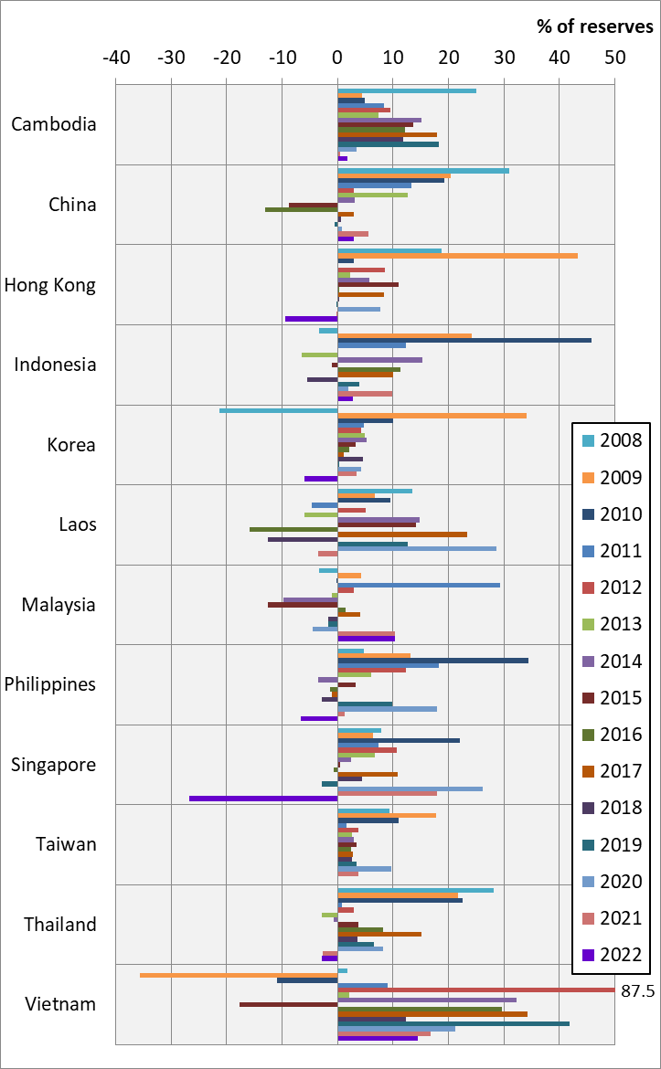
Chart 11.1 Reserve Asset Flows, 2008-2022
See also, Asia Economics Blog, 13 June 2023
Notes:
Data source:
IMF International Financial Statistics
Balance of Payments, Analytic Presentation, Reserves and related items [BPM6], US Dollar
International Reserves and Liquidity, Reserves, Official Reserve Assets, Market Value/Price, US Dollar
Central Bank of the Republic of China (Taiwan)
Balance of Payments, Reserve Assets

