Slide 1
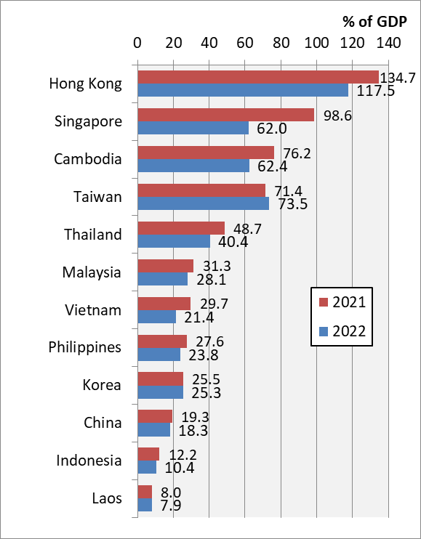
Chart 11.3 Official Reserves/GDP, 2021-2022
Notes:
Data sources: reserves, IMF International Financial Statistics; GDP, IMF World Economic Outlook April 2023 (contains some preliminary estimates); Taiwan, Central Bank of the Republic of China (Taiwan)
https://data.imf.org/?sk=4C514D48-B6BA-49ED-8AB9-52B0C1A0179B&sId=1390030341854
https://www.imf.org/en/Publications/WEO/weo-database/2023/April
https://cpx.cbc.gov.tw/Tree/TreeSelect?mp=2

