Slide 1
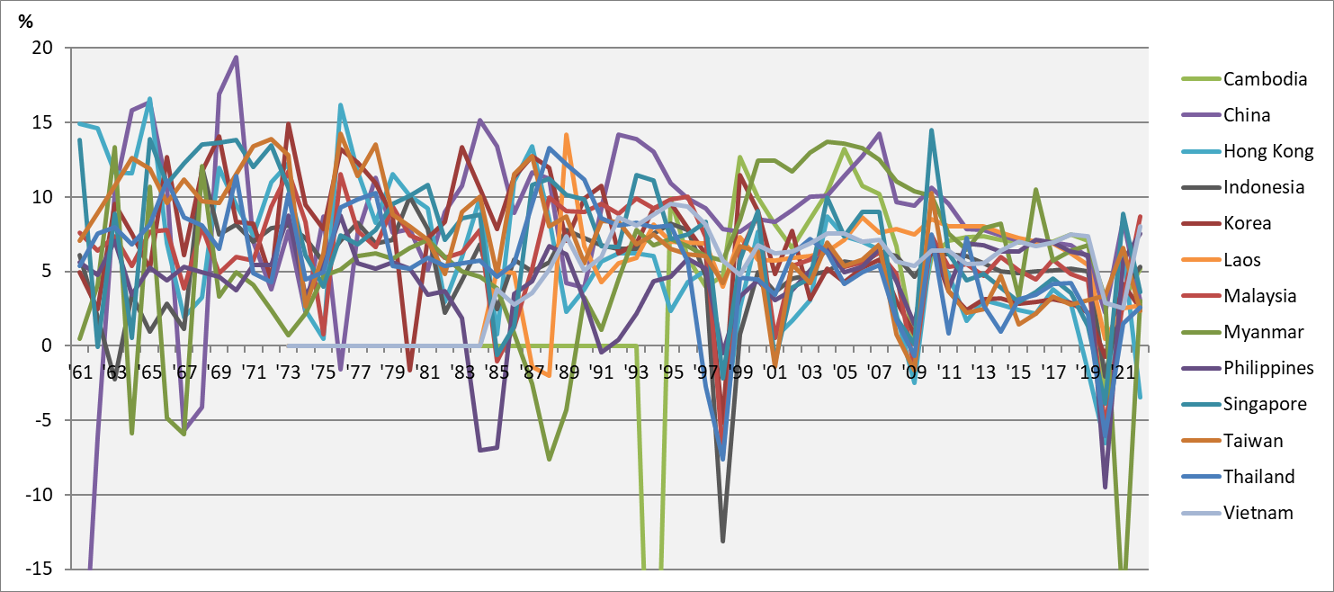
Chart 1.2 GDP Growth Rates Superimposed, 1961-2022
Notes:
Data sources:
World Bank World Development Indicators;
National Statistics, R.O.C.(Taiwan), https://nstatdb.dgbas.gov.tw/dgbasall/webMain.aspx?k=engmain.

