Slide 1
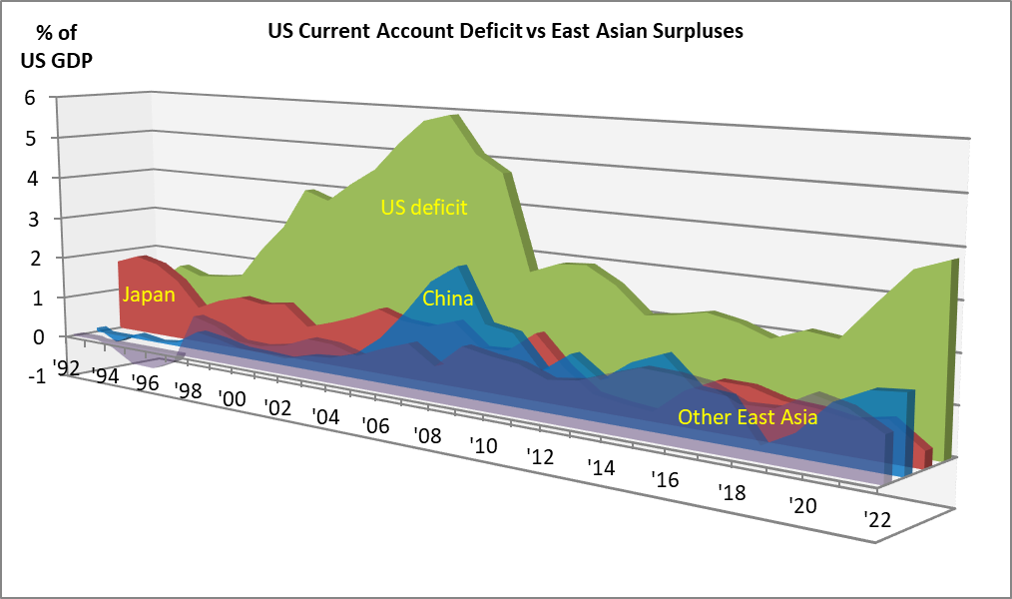
Box 5.1 Global Current Account Imbalances

