Slide 1
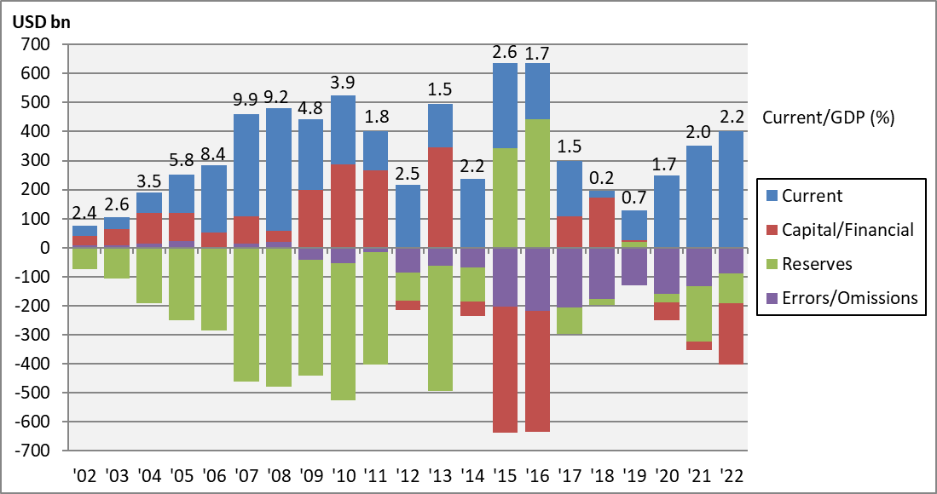
Chart 5.1 Balance of Payments, China, 2002-2022
Notes:
Data sources: balance of payments, IMF International Financial Statistics; GDP, World Bank World Development Indicators.

