Slide 1
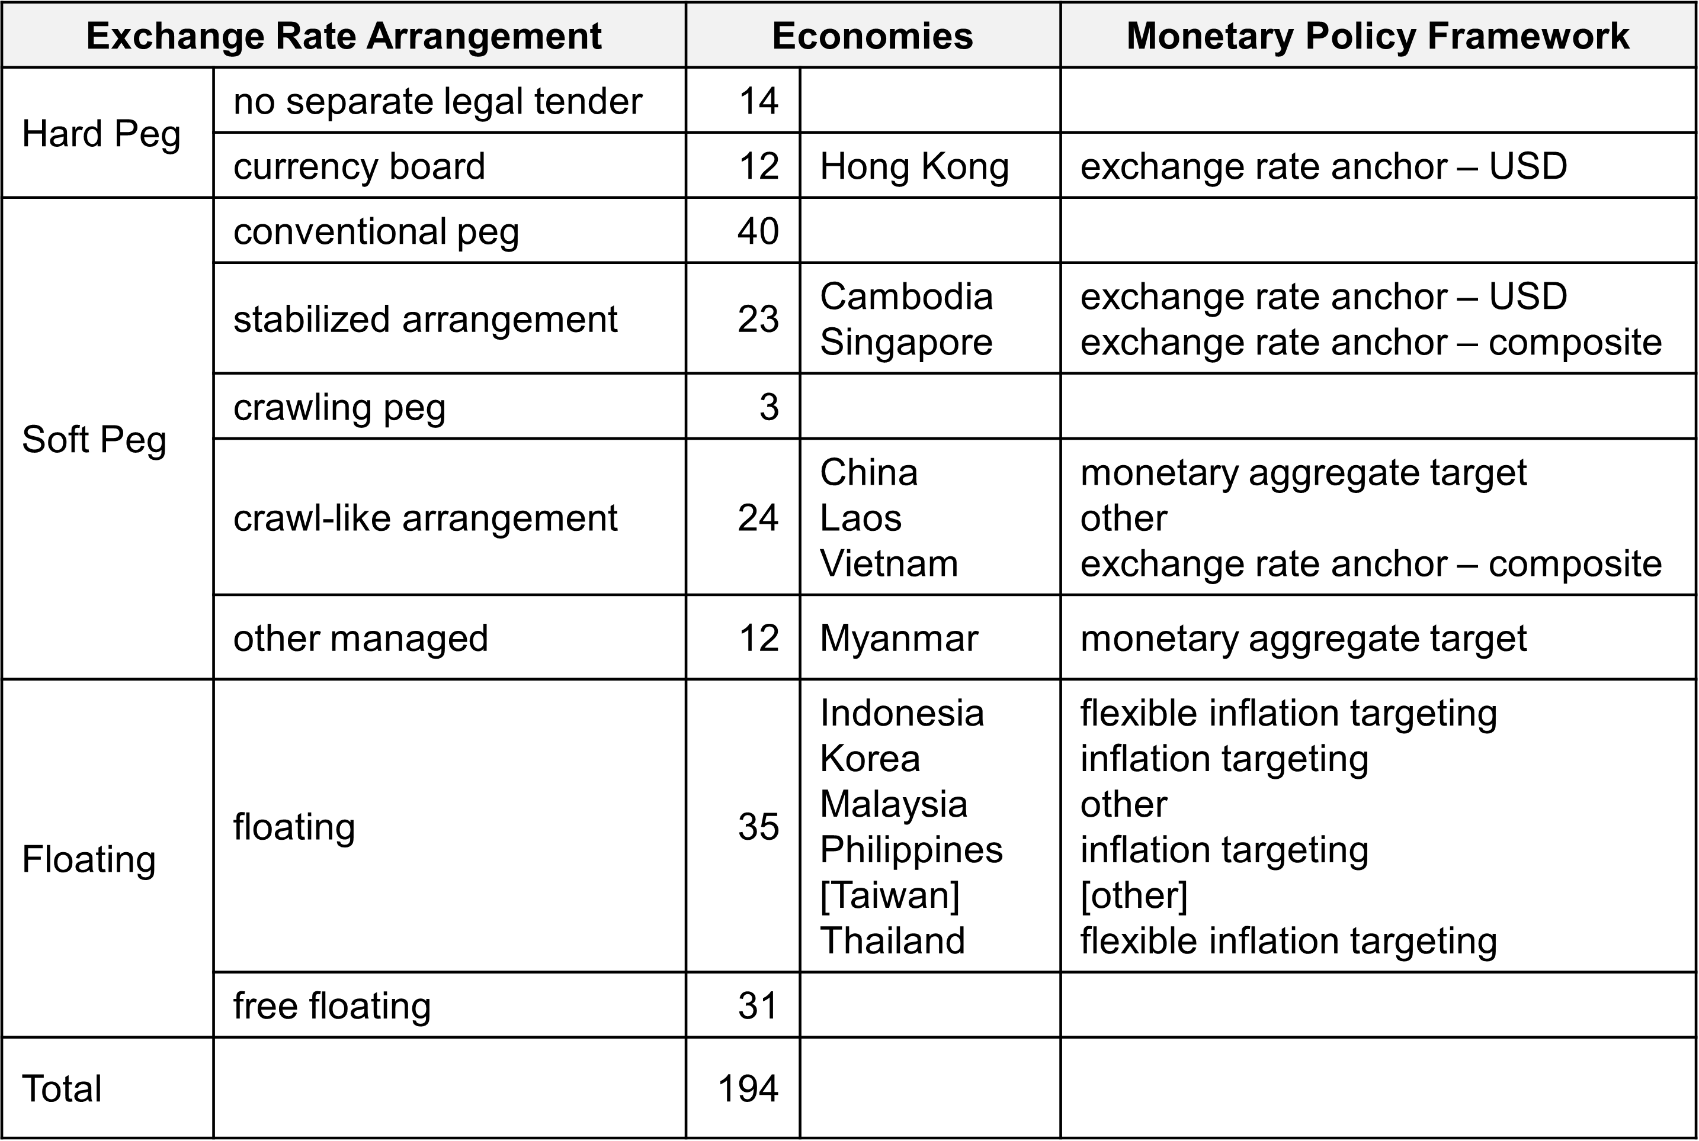
Table 11.1 Monetary Policy Framework, 2022
Notes:
IMF Annual Report on Exchange Arrangements and Exchange Restrictions
https://www.imf.org/en/Publications/Search?#sort=relevancy&f:series=[ANNREPEAER]&DateTo=12%2F31%2F2023&DateFrom=1%2F1%2F2023

